Slide 1
Project:
Simulated phishing attack using zphisher.

Slide 2
Simulated phishing attack using zphisher in a controlled lab environment to demonstrate social engineering vulnerabilities.

Slide 3
Agenda
The main agenda outlined in the slide is to find out how password cracking works using an automated phishing tool called Zphisher to steal credentials from various social media platforms..

Slide 4
Research
Credential Harvesting: Analyzing how attackers use automated toolkits to replicate legitimate login pages.
Social Engineering: Investigating how users are manipulated into entering private credentials on spoofed sites.
Phishing Automation: Studying the mechanics of open-source phishing frameworks (like Zphisher) to understand their deployment methods and vulnerabilities.
Cybersecurity Defense: Evaluating how organizations and individuals can detect, block, and mitigate these specific automated social engineering attacks

Slide 5
Introduction
Phishing remains one of the most successful cyberattack techniques.
Toolkits that automate phishing workflows — such as Zphisher (commonly discussed in security communities) — make it easier for attackers to scale social-engineering campaigns.
Zphisher is known within security circles as an automated phishing toolkit (a family of scripts and templates) that streamlines the creation of fake login pages and assists attackers in delivering social-engineering lures. At a conceptual level, such toolkits typically combine:

Slide 6
TOOLS USED
1-KALI LINUX
2-ZPISHER

Slide 7
Commands Used
Just, Clone this repository and install
git clone --depth=1 https://github.com/htr-tech/zphisher.git

Slide 8
Commands Used
Now go to cloned directory and run zphisher.sh
cd zphisher
bash zphisher.sh

Slide 9
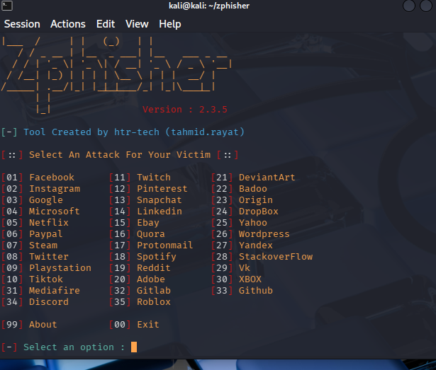
Output for this

Slide 10
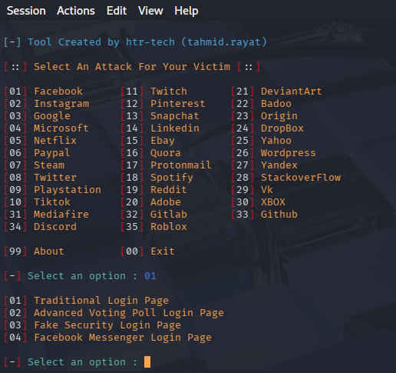
Now we target facebook and select the number 01
2

Slide 11
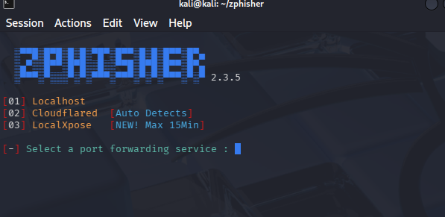
Now we can select the Facebook messenger login page 04

Slide 12
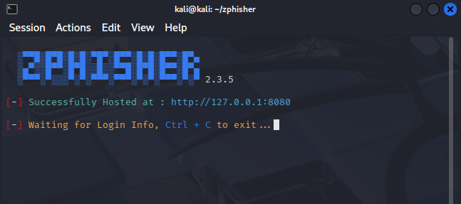
We find out the target ip http://127.0.0.1:8080

Slide 13
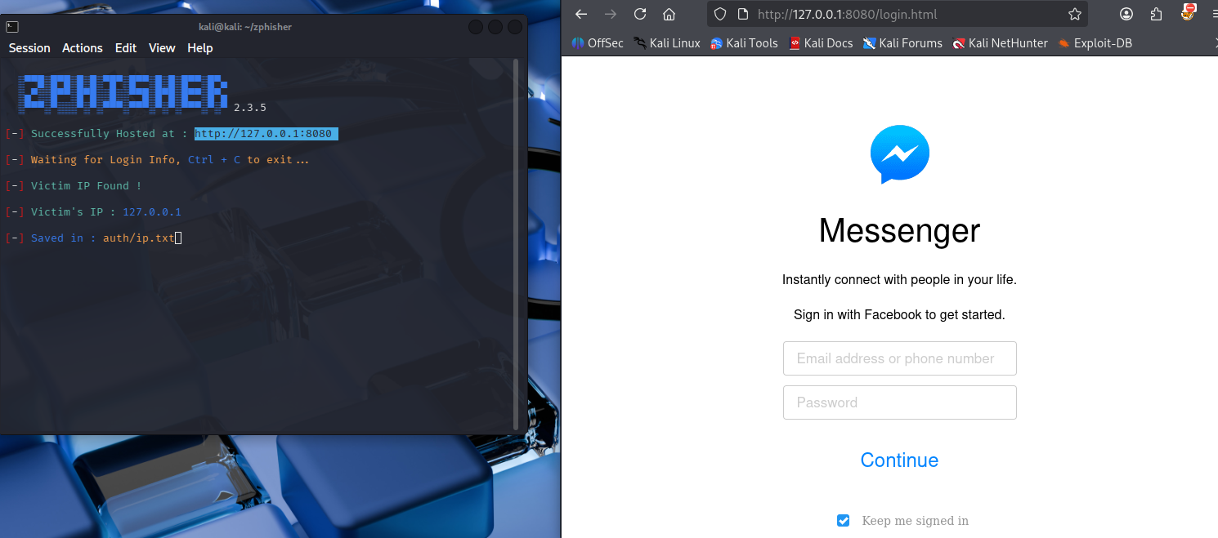
Now I found the messenger login page

Slide 14
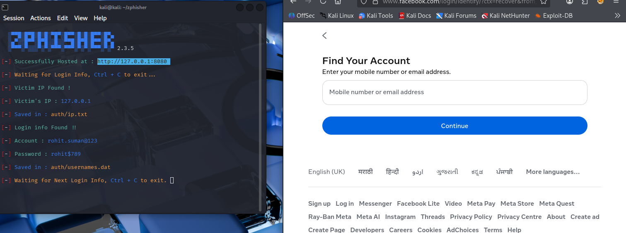
Now I find out what the victim typing his machine and still his data successfully.

Slide 15
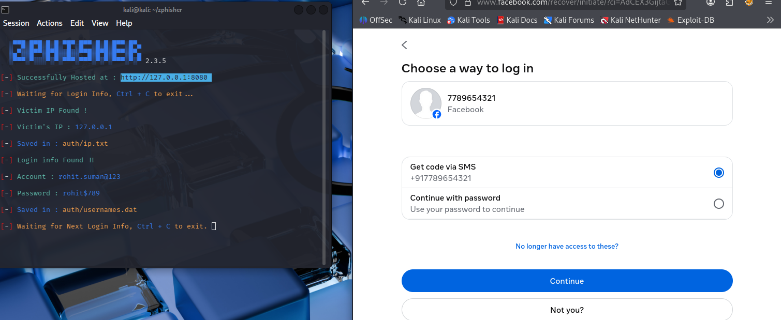
Once the victim put his contact no it also still his sensitive data

Slide 16
Questions ?

Slide 17
Thank You!

